Slide 1
Teaching Machines to Read
Class 2

Slide 2
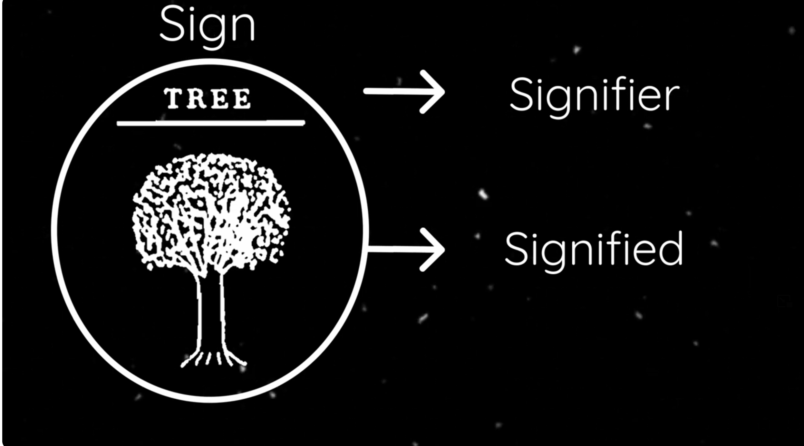
Ferdinand de Saussure 1857-1913
Swiss, father of structuralism
Language is a system of signs:
A sign is a combo of signifier-signified (and later, referent)
There is no natural relation between signifier and the signified
Opposition Theory:
A sign’s value is determined by
Within the same language, all words used to express related ideas limit each other reciprocally; synonyms like French redouter 'dread', craindre 'fear,' and avoir peur 'be afraid' have value only through their opposition: if redouter did not exist, all its content would go to its competitors.
Notes:
https://www.youtube.com/watch?v=ay0eInGVtfU source of image, good lecture

Slide 3
Implications for Language Acquisition?
If opposition theory is true, language has to be acquired either wholesale or is doomed to never be learnt
Sapir-Whorf Hypothesis

Slide 4
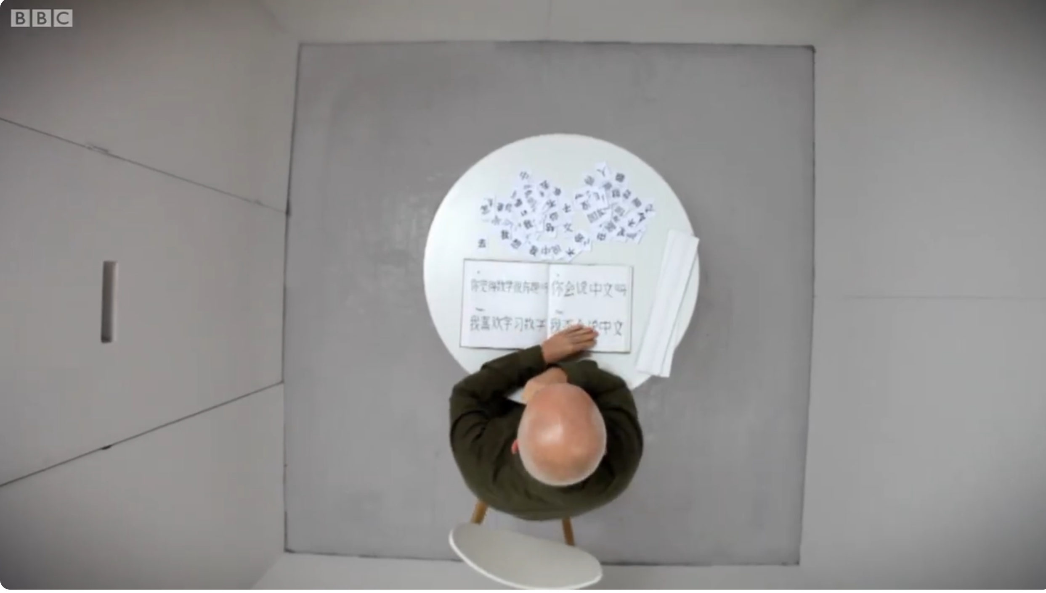
John Searle and the Chinese Room
Notes:
https://www.youtube.com/watch?v=D0MD4sRHj1M

Slide 5
John Searle and the Chinese Room
Nǐ huì shuō zhōngwén ma?
Can you speak Chinese?
Notes:
https://www.youtube.com/watch?v=D0MD4sRHj1M

Slide 6
Implications for Language Acquisition?
Argument/observation: neither Searle nor the room understand Chinese
Hence, …
without "understanding" )"intentionality"), we cannot describe what the machine is doing as "thinking"
Q: does this have any falsifiable predictions?

Slide 7
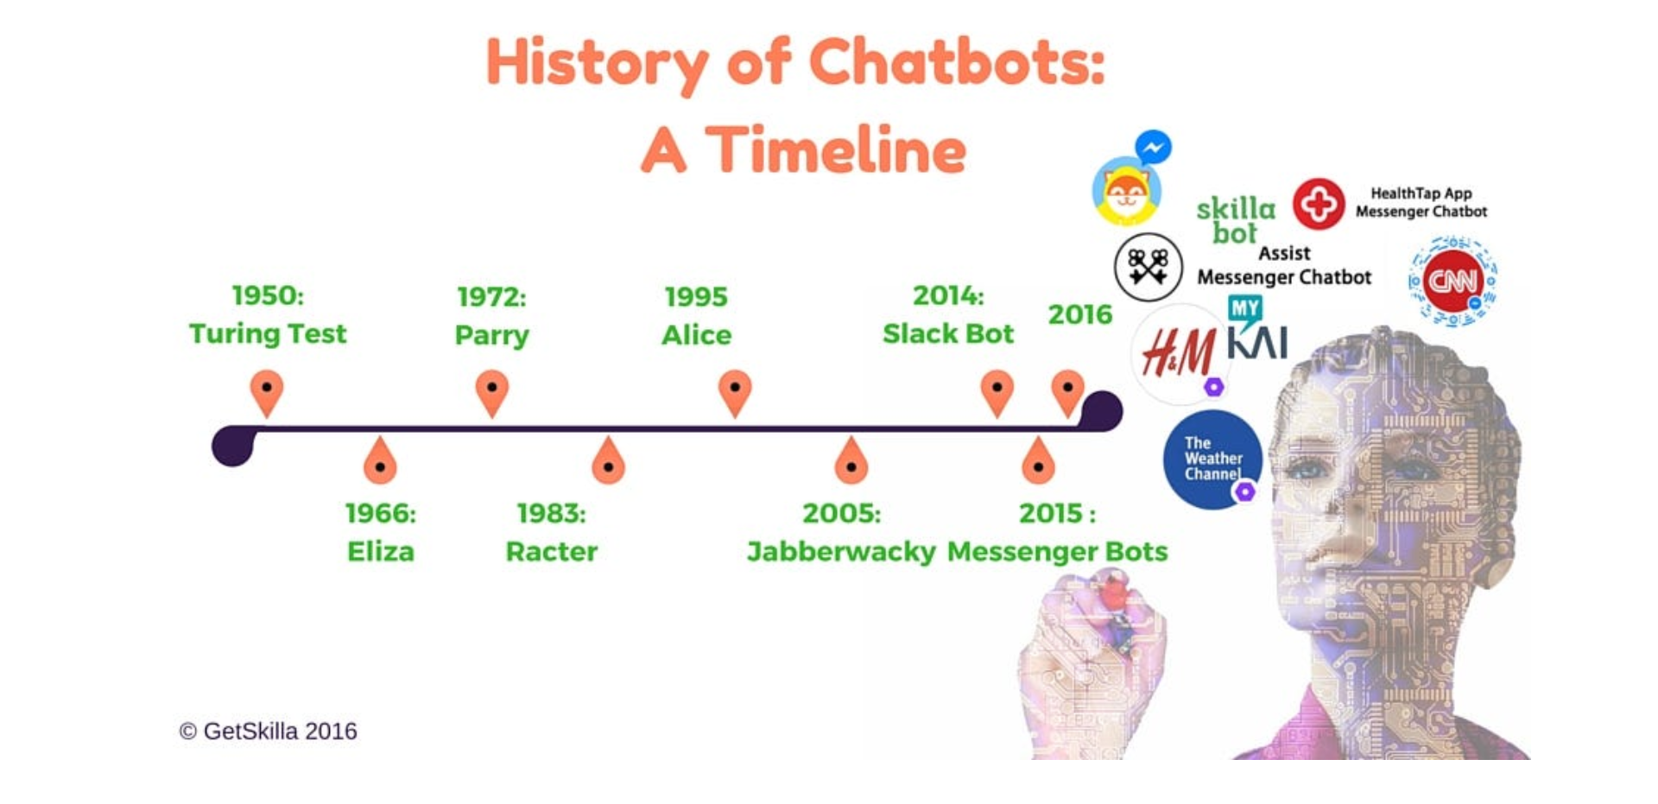
History
1960

Slide 8
Corpus Linguistics
https://www.english-corpora.org/coca/ (sign up please)
one billion words of text (25+ million words each year 1990-2019)
Eight genres: spoken, fiction, popular magazines, newspapers, academic texts, TV and movies subtitles, blogs, and other web pages.
Search in COCA:
Gargantuan
Demure

Slide 9
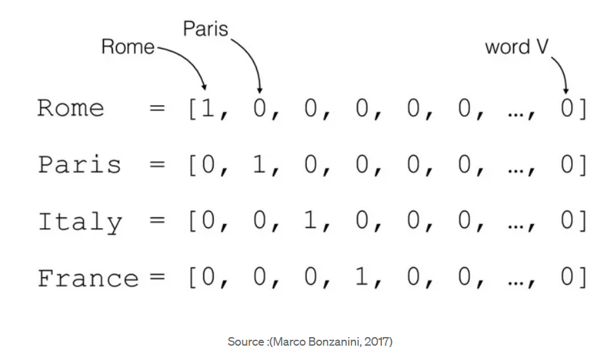
From Words to Numbers
How do you do that?
Dictionary index
One hot
Considerations:
New words
Relationships

Slide 10
TF-IDF
D1: "The court finds the defendant guilty."
D2: "The defendant pleads not guilty."
D3: "The court issues a ruling in favor of the plaintiff."
Calculate the TF term frequency of the word "defendant" in each document.

Slide 11
Stage 1 = calculate the TF
In document 1, what’s the frequency of “defendant”?
Document 2?
Document 3?
TFD1​=1/6​≈0.167
TFD2​=1/5​=0.2
TFD3​=0

Slide 12

Stage 2: Calculate the the IDF
$IDF=log10​(\frac{DF}{Total number of documents}​)$
DF = in how many documents the term appears?
What’s the total number of documents?
IDF = log( $\frac{Total number of Documents}{DF})=$
$log\left(\frac{3}{2}\right)=log\left(1.5\right)=0.176$

Slide 13
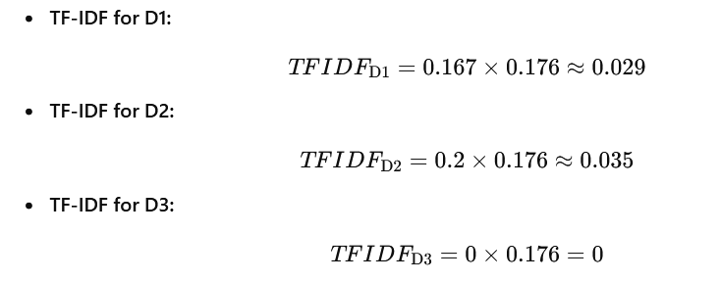
Last Stage: Finally…
Multiply the TF by the IDF
The TF-IDF scores indicate that the word "defendant" is slightly more significant in D2 than in D1, as it has a higher TF-IDF score. The word does not appear in D3, so its TF-IDF score is 0 for that document.

Slide 14
Distributional Hypothesis (Time Permitting)
Birds of a kind flock together

